Slide 1
Reproductive Biology and Technology:
Maximizing Odds of Pregnancy with Artificial Insemination
Bryan Reiling*, David Grieger**, Andrea Cupp*, Landon Tadich*
Nathan Conner*, Taylor Ruth*, Christopher Stripling***
*University of Nebraska-Lincoln
**Kansas State University
***University of Tennessee
Funded by a USDA-NIFA-PDAL grant, Award Number 2021-67037-34298, Program A7501.
Notes:
For those engaged in livestock production, reproductive performance is often considered the trait of greatest economic importance. This lesson and associated inquiry-based learning activity functions to help students learn about reproductive biology and technology as they attempt to maximize the odds of pregnancy with artificial insemination.
NEXT SLIDE

Slide 2
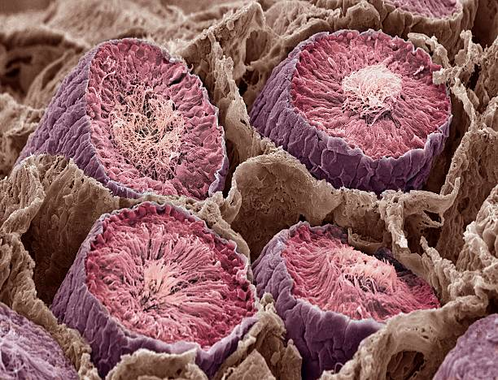
Male Reproductive Organs and Function
Testes
  Spermatozoa (male gamete) production
    From the seminiferous tubules
    Continual process after puberty
  Testosterone production
    From Leydig cells of testes
    Functions
      Masculine appearance and behavior
      Growth
Seminiferous tubules
Photo credit: Steve Gschmeissner, Getty Images
Notes:
Before starting, however, let’s study basic biological components of the reproductive system. Obviously, a primary male organ of reproduction is the testes. The testes (CLICK) is responsible for spermatozoa production. The spermatozoa is the male gamete, and this is generated from within the seminiferous tubules of the testes. This is a continual process once the male reaches puberty.
(CLICK), the testes also generates testosterone from the Leydig cells. Testosterone is important for the development of secondary sex characteristics, masculine appearance and behavior, and facilitates growth.
NEXT SLIDE

Slide 3
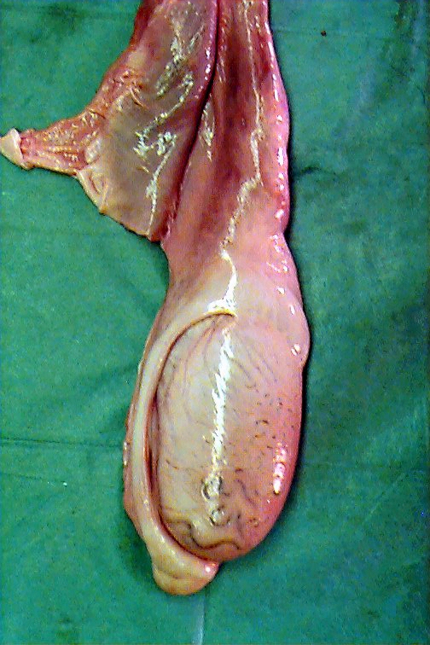
Male Reproductive Organs and Function
Epididymis
  Concentration of spermatozoa
  Storage & maturation site
Scrotum
  Provides support & protection for testes
  Temperature regulation for sperm viability
    Maintains temp 7-10ºF (4-6ºC) below body temp
Epididymis
Notes:
The epididymis, which is a structure that wraps around one side of the testes, is responsible for concentration of the spermatozoa. It’s also where the spermatozoa is stored and allowed to mature to maximize fertility.
CLICK – The scrotum provides support and protection for the testes, but it’s also important for temperature regulation. The male biologically strives to maintain temperature of the spermatozoa 7-10 degrees F below body temperature.
NEXT SLIDE

Slide 4
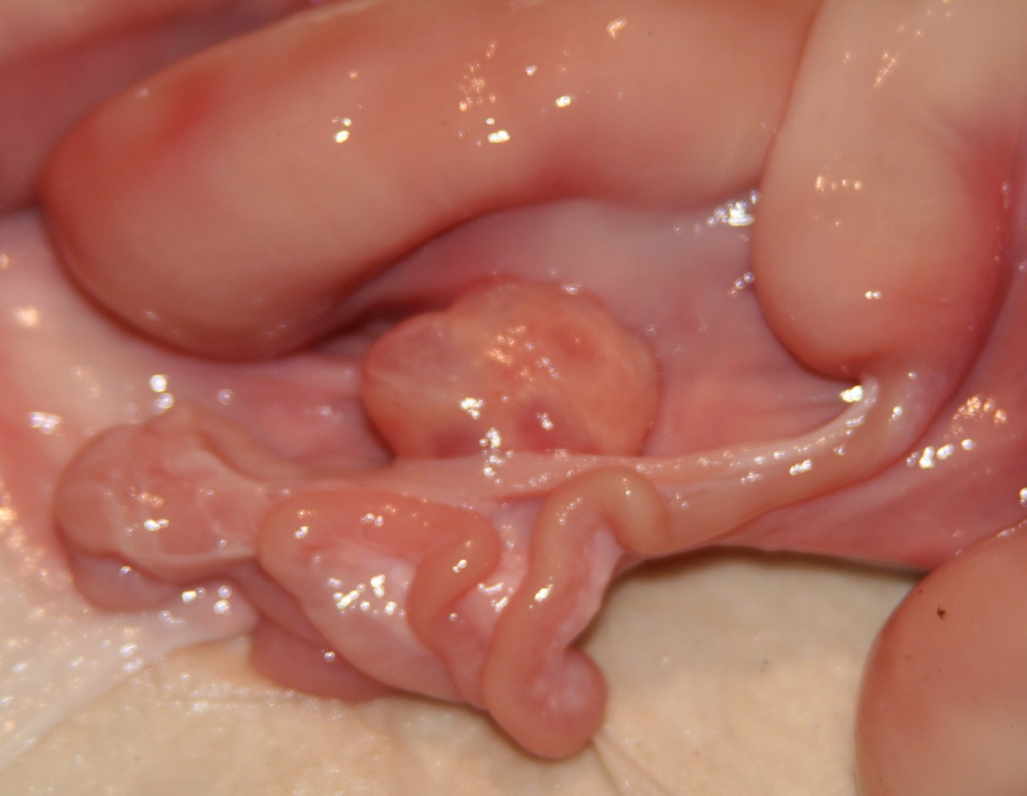
Female Reproductive Organs and Function
Ovaries (female gonad)
  Contain the oocytes
Oviducts (Fallopian tube)
  Site of fertilization
  Transport of eggs to the uterus
The Ovary
This slender tubule is the oviduct!
Notes:
Female reproductive organs of importance include the ovary or female gonad. It is the ovary that contains the oocytes or eggs to be ovulated. This is a (CLICK) picture of the ovary from a gilt or young female pig. Next (CLICK), the oviducts or Fallopian tube. This slender tubule as you can see in the picture is the site of fertilization, and it is responsible for transportation of eggs, hopefully fertilized eggs, to the uterus.
NEXT SLIDE

Slide 5
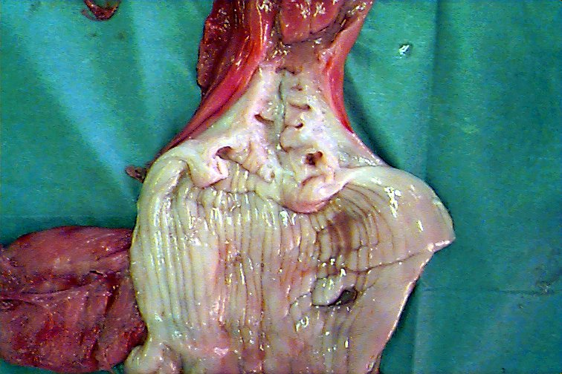
Female Reproductive Organs and Function
Uterus
  Site of pregnancy
  Responsible for expulsion of the fetus
Cervix
  Storage reservoir & passageway for spermatozoa during natural service
  “Gateway” between uterus & vagina
Notes:
The uterus is the site of pregnancy; that is where the fetus will develop. Upon parturition, or the process of birth, the uterus, being a muscular organ, is responsible for expulsion of that fetus through increased strength and frequency of contractions.
(CLICK), of paramount importance to the AI technician is the cervix. In a natural mating, the bull will deposit semen into the cervix which then serves as a storage reservoir and passageway for the spermatozoa. It’s also the “gateway”, if you will, between the internal and external environment of the female reproductive tract.
NEXT SLIDE

Slide 6
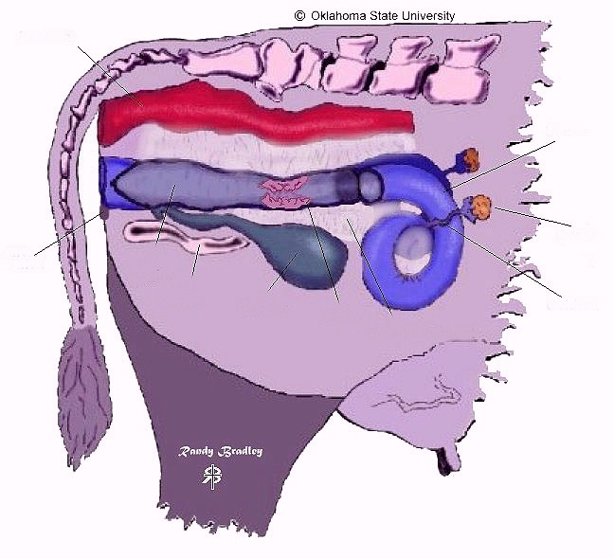
Rectum
Uterus
Ovary
Vagina
Vulva
Oviduct
Pelvis
Bladder
Cervix
Notes:
Since this lesson discusses the usage of artificial insemination with cattle, as a model, let’s provide some reference for where the various organs are anatomically located.
CLICK – First, the vulva represents the external genetalia, and it is through the vulva that the AI technician will need to insert the AI rod.
CLICK – Next is the vagina, and (CLICK), the pelvis. Now the bladder (CLICK) has nothing to do with reproduction, but for veterinarians, reproductive physiologists, and others it’s important to know the approximate location of the bladder so one doesn’t mistake the fluid present in the bladder for the fluid that may be associated with a pregnancy. Then, the (CLICK) cervix. An AI technician must be able to identify the cervix, for he/she must be able to guide the AI rod through that structure. Then, there is the (CLICK) uterus which splits into two horns, with an (CLICK) oviduct, and (CLICK) ovary associated with each horn.
Finally, the rectum (CLICK), which is part of the digestive tract. Why is this important? Because with AI, while the technician will guide the AI rod through the reproductive tract, he/she will insert their arm through the rectum and into the digestive tract. Then they will be able to palpate and handle the various reproductive organs and structures through the digestive tract.
NEXT SLIDE

Slide 7
Basic Reproductive Terminology
Estrus – female is receptive to mating
Estrous cycle – time period extending from the onset of one estrus to onset of the next estrus period
  estrus to estrus
Ovulation – release of egg from ovary
Gestation – pregnancy
Parturition – giving birth
Notes:
Some basic reproductive terminology. Estrus, spelled e-s-t-r-u-s, is when the female is receptive to mating. The Estrous cycle (CLICK), with estrous now spelled e-s-t-r-o-u-s, represents the time period extending from the onset of estrus to the onset of the next estrus period. For most farm animal species, this will be approximately 21 days. (CLICK), ovulation is release of the egg, (CLICK), gestation is pregnancy, and (CLICK), parturition is the generic term for giving birth.
NEXT SLIDE

Slide 8
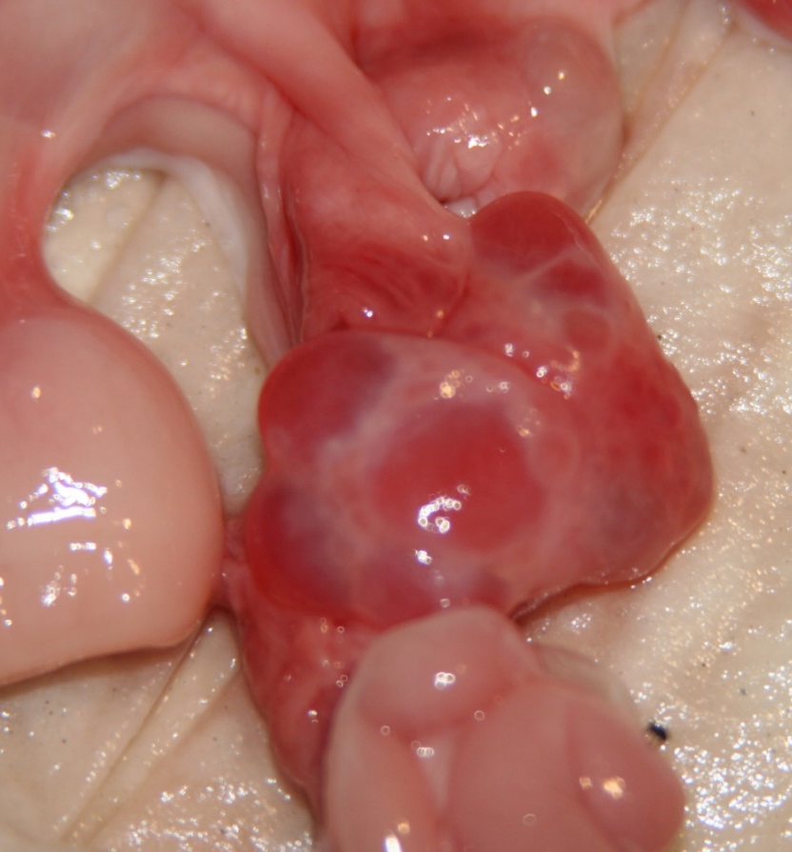
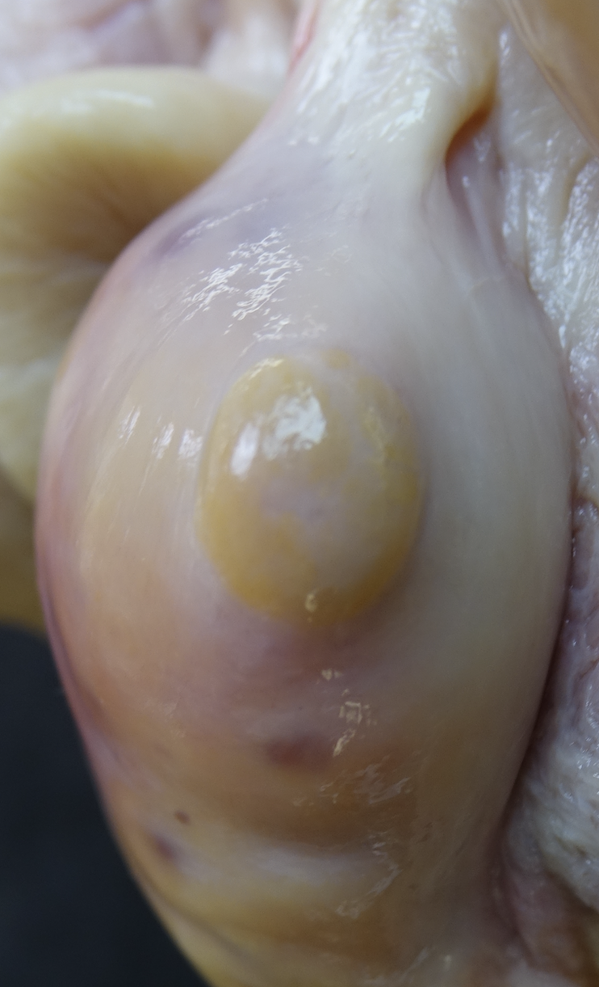
Ovarian Structures During the Estrous Cycle
Follicles
  Fluid-filled structures on the ovary
  Contain the egg
  Secrete estrogen
Corpus luteum (CL)
  Structure that forms after ovulation of follicle
  “yellowish” body on the ovary
  Secretes progesterone
Follicles
Corpus
luteum
Notes:
On the ovary, there are two structures of importance to success with artificial insemination. Those are the follicles and the corpus luteum. The follicles (CLICK) are fluid-filled structures that contain the egg. As the follicles grow, they secrete estrogen (CLICK). The larger the follicle, the more estrogen that is secreted. The corpus luteum or CL (CLICK) is a structure that forms after ovulation of the follicle. It will develop a “yellowish” color, and it secretes progesterone (CLICK). Again, the larger the CL, the more progesterone it secretes.
NEXT SLIDE

Slide 9
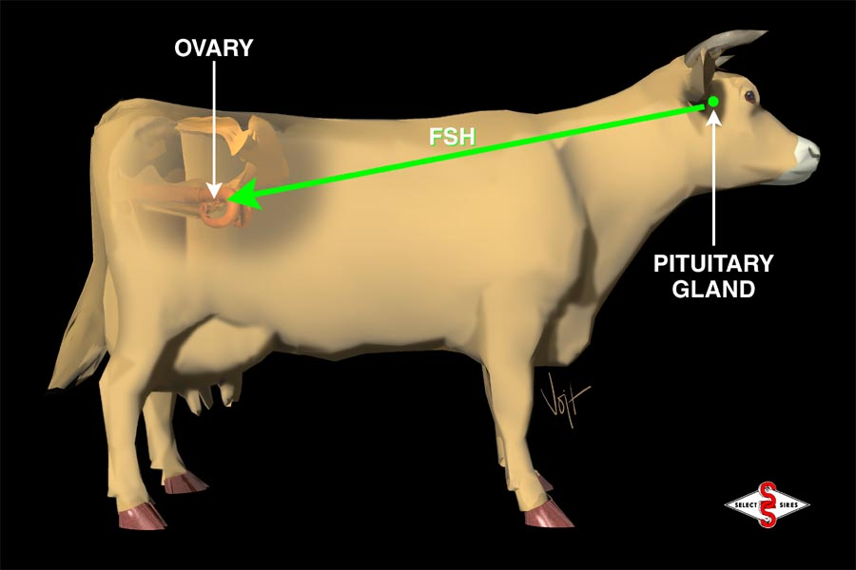
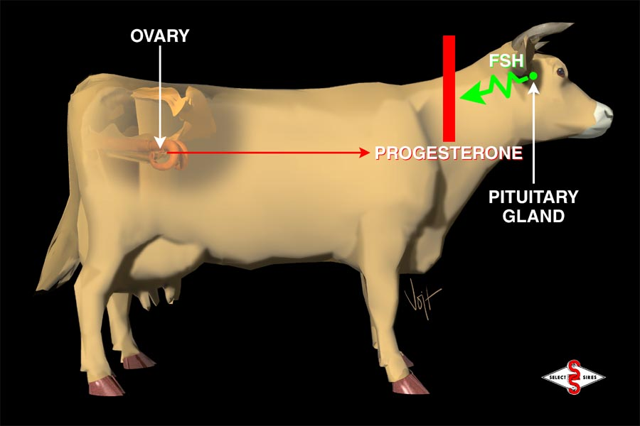
Major Female Hormones of Reproduction
Follicle Stimulating Hormone (FSH)
  Follicular growth & development
Estrogen
  Secreted from the preovulatory follicle
  Growth & development of uterus
  Estrous behavior
  Secondary sex characteristics
Luteinizing Hormone (LH)
  Induces ovulation
Progesterone
  Secreted from corpus luteum (CL)
  Blocks release of FSH from pituitary
    No estrus, no ovulation
Notes:
There are several hormones involved with reproduction, but let’s focus on the function of four.
CLICK – Follicle Stimulating Hormone or FSH does exactly what its name implies. It stimulates follicular growth and development.
CLICK – Estrogen is secreted from the preovulatory follicle. As the follicle gets bigger, it secretes more estrogen. Estrogen is responsible for growth and development of the uterus. It would be analogous to a mother preparing the nursery for a baby about to be born. Estrogen is responsible for estrous behavior and development of secondary sex characteristics. For artificial insemination to be successful, detection of estrous behavior is critically important.
CLICK – Through a feedback mechanism, once a threshold level of estrogen is reached, Luteinizing Hormone or LH is released to induce ovulation and release of the egg.
CLICK – Progesterone is secreted from the corpus luteum, a structure that forms on the ovary after ovulation of the follicle. Again, as the CL grows in size, the more progesterone that is secreted. The role of progesterone is to maintain the pregnancy by effectively placing a “roadblock” on the release of FSH from the pituitary gland. There is no FSH, the follicles can’t grow, and the cow will not show estrus, and there will be no ovulation.
NEXT SLIDE

Slide 10
The Estrous Cycle of the Cow
Length of estrous cycle = 21 days
Estrogen level,
size of preovulatory
follicle
Progesterone level,
size of corpus luteum
estrus
estrus
0 5 10 15 21
days of estrous cycle
Notes:
While in the previous slide, I mentioned 4 different reproductive hormones that cascade upon one another to facilitate reproductive function in the female, let’s narrow it down to only two hormones that we can measure and monitor throughout the estrous cycle. Those are estrogen and progesterone.
CLICK – If you recall, estrogen is secreted by the preovulatory follicle. The larger the follicle, the closer it is to ovulation. Also, the larger the follicle, the more estrogen that is released, and estrogen facilitates mating behavior.
CLICK – Now, progesterone. Progesterone is secreted by the corpus luteum. Again, the larger the corpus luteum, the more progesterone that is secreted. Progesterone’s function is to maintain the pregnancy and to keep heat from recurring. If the egg has been fertilized and is actively growing, there is no need for the cow to come back into estrus. Thus, when progesterone is high, estrogen will be low, and vice versa. Ovulation only occurs in the presence of high estrogen levels.
NEXT SLIDE

Slide 11
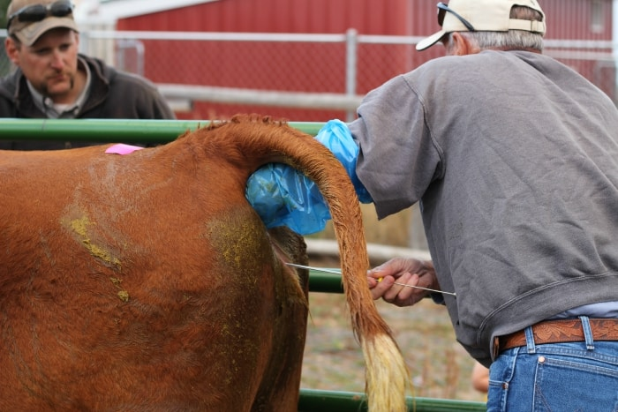
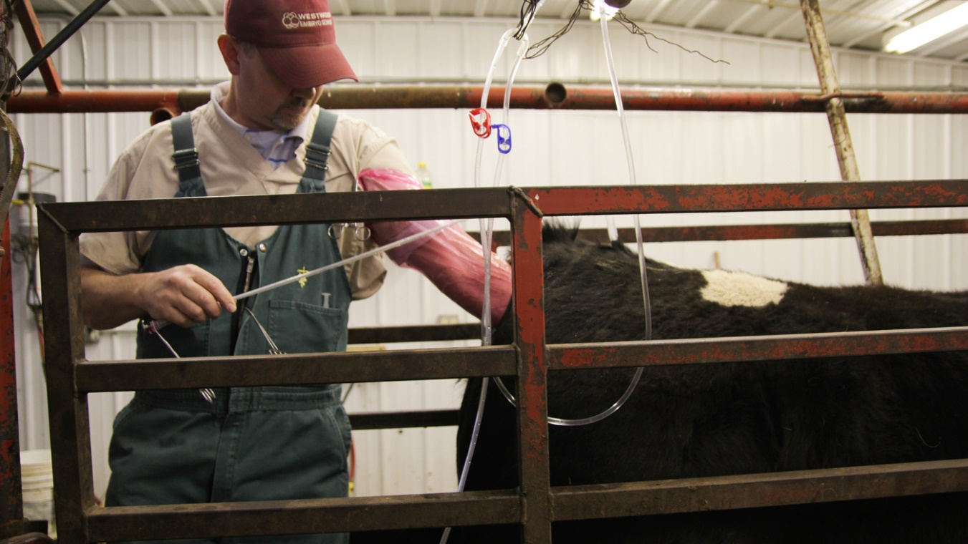
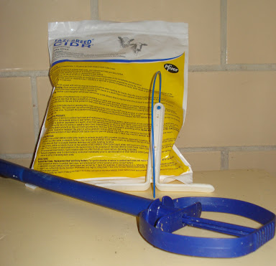
Applications of Reproductive Biology
Artificial Insemination
Estrous synchronization
Embryo transfer
Notes:
We now know the basics of reproductive biology. That knowledge has evolved into development of several applications including artificial insemination, estrous synchronization, and embryo transfer. We will focus on artificial insemination.
For teachers, unless you had students complete the inquiry-based learning activity first, I would now recommend that students complete that activity and answer the associated questions. The activity is designed to help students further understand the physiology of reproduction along with numerous other factors that influence the probability of pregnancy with usage of artificial insemination in cattle. While it is focused on cattle, much of what is discussed and learned is applicable to other mammalian species.
The balance of this presentation will provide a focus on those questions.
NEXT SLIDE

Slide 12
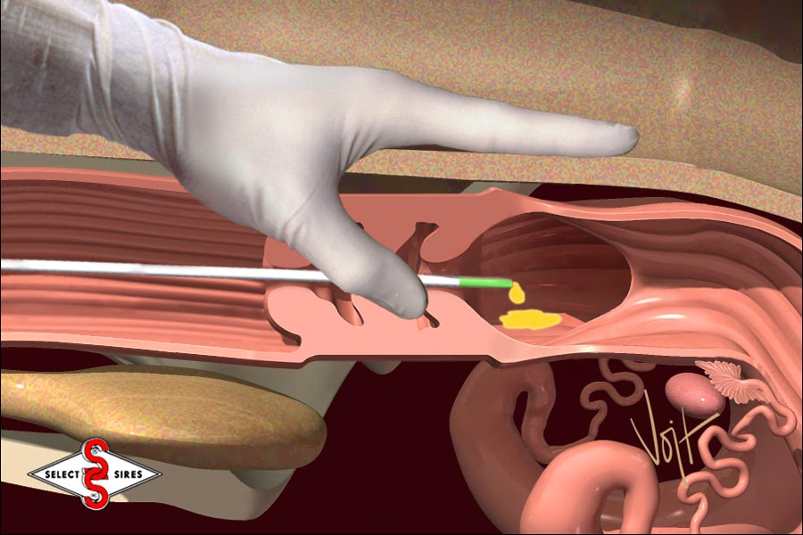
Artificial Insemination
↑ Genetic Potential
↓ Disease
Safety
Notes:
There are numerous advantages associated with usage of artificial insemination (AI) in animal agriculture, including (but not limited to)
-- (CLICK), increased rate of genetics improvement through access and usage of superior sires,
-- (CLICK), decreased rate of disease transmission, especially reproductive or venereal diseases,
-- (CLICK), and enhanced safety for farm/ranch personnel with fewer intact breeding males needed.
However, increased pregnancy rate is NOT an advantage associated with artificial insemination. Natural service pregnancy rates almost always exceed those of artificial insemination, even with experienced technicians. Why is this, and how can we maximize the odds of pregnancy when using artificial insemination?
NEXT SLIDE

Slide 13
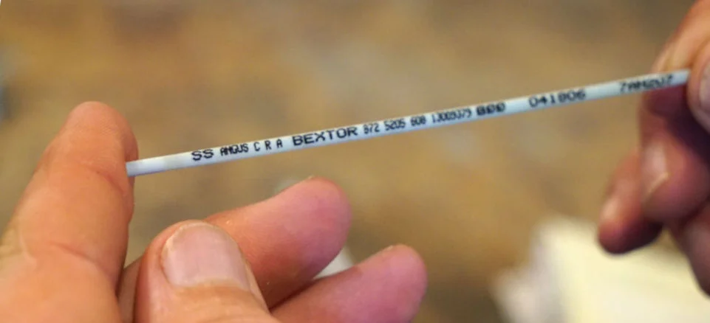
Semen Characteristics of the Bull
Species | Semen Volume (ml) | Concentration Sperm/ml (10⁶)
Bull | 3-8 | 600-2000
Ram | 0.8-2.0 | 2000-3000
Stallion | 60-100 | 150-300
Boar | 150-350 | 200-300
That’s 600 million
to 2 billion!
Photo from Western Livestock Journal
In general, as semen volume ↑,
sperm concentration ↓.
Notes:
The first reason that AI pregnancy rates often fall below that of natural service is simple math and probability …
The bull only produces 3-8 ml of semen per ejaculate, but
It’s extremely concentrated … (CLICK) 600 million to 2 billion spermatozoa per ml. That’s …
2.4 to 16 billion spermatozoa (give or take a couple hundred million), per ejaculate.
With usage of AI, merely 20 million sperm are commonly placed into a straw of commercial frozen semen (CLICK). That’s less than 0.25% of what the bull would naturally deliver. If working with sexed semen, only 4 million spermatozoa are placed in the straw!
If curious about other species (CLICK) ….
CLICK – In general, as semen volume increases as with the stallion or boar, the sperm concentration decreases, and vice-versa.
NEXT SLIDE

Slide 14
Artificial Insemination – Semen Handling
Thawing Temperatures
  95ºF is optimal
  Lower temperatures → thaw too slow
  Higher temperatures → Heat shock
Does the water need to be wiped off?
  Yes, water is toxic to the spermatozoa
Should one “shake down” the straw?
  Yes, it pushes thawed semen away from where you will cut the straw.
Notes:
Thawing temperatures
CLICK – 95ºF is considered the optimal thaw temperature. If the temperature is lower (CLICK), the semen will thaw too slow resulting is losses. Higher temperatures (CLICK) cause heat shock and death of the spermatozoa.
Does the water need to be wiped off, after removing the straw from the water bath?
CLICK -- Yes, water is toxic to the spermatozoa, and while all sperm in the straw will not contact this water, those that do (after cutting open the straw) will likely die.
Should one shake down the straw?
CLICK -- Yes. The purpose of “shaking” down the straw is to push the thawed semen away from where the straw will be cut allowing the semen to eventually be dispelled from the straw. If not done, some semen will be lost with the straw is cut.
NEXT SLIDE

Slide 15
Artificial Insemination – Semen Handling
On what end should the straw be cut?
  Crimped end.
  Otherwise, plug will be lost,
    plunger component of AI rod will not be able to push semen out of the straw.
How much of the straw should be removed?
  3/8 to ½ inch.
  If less is cut, the sheath will not fit tightly over the straw and AI rod.
  If more is cut, some semen will be lost when cutting.
Transport of AI rod to the cow
  Inside technician’s shirt, next to the skin
  Keeps semen warm to prevent cold shock of spermatozoa
Notes:
On what end of should the straw be cut?
CLICK – The crimped end. Otherwise, the plug will be lost and the plunger component of the AI rod will not be able to push semen out of the straw.
How much of the straw should be removed?
CLICK -- 3/8 to ½ inch. If less is cut, the sheath will not fit tightly over the straw and AI rod. If more is cut, some semen will be lost when cutting.
How should one transport the AI rod to the cow?
CLICK – It is recommended that the prepared AI rod be placed inside the technicians shirt, next to the skin. This functions to keep the semen warm and will prevent cold shock of the spermatozoa.
NEXT SLIDE

Slide 16
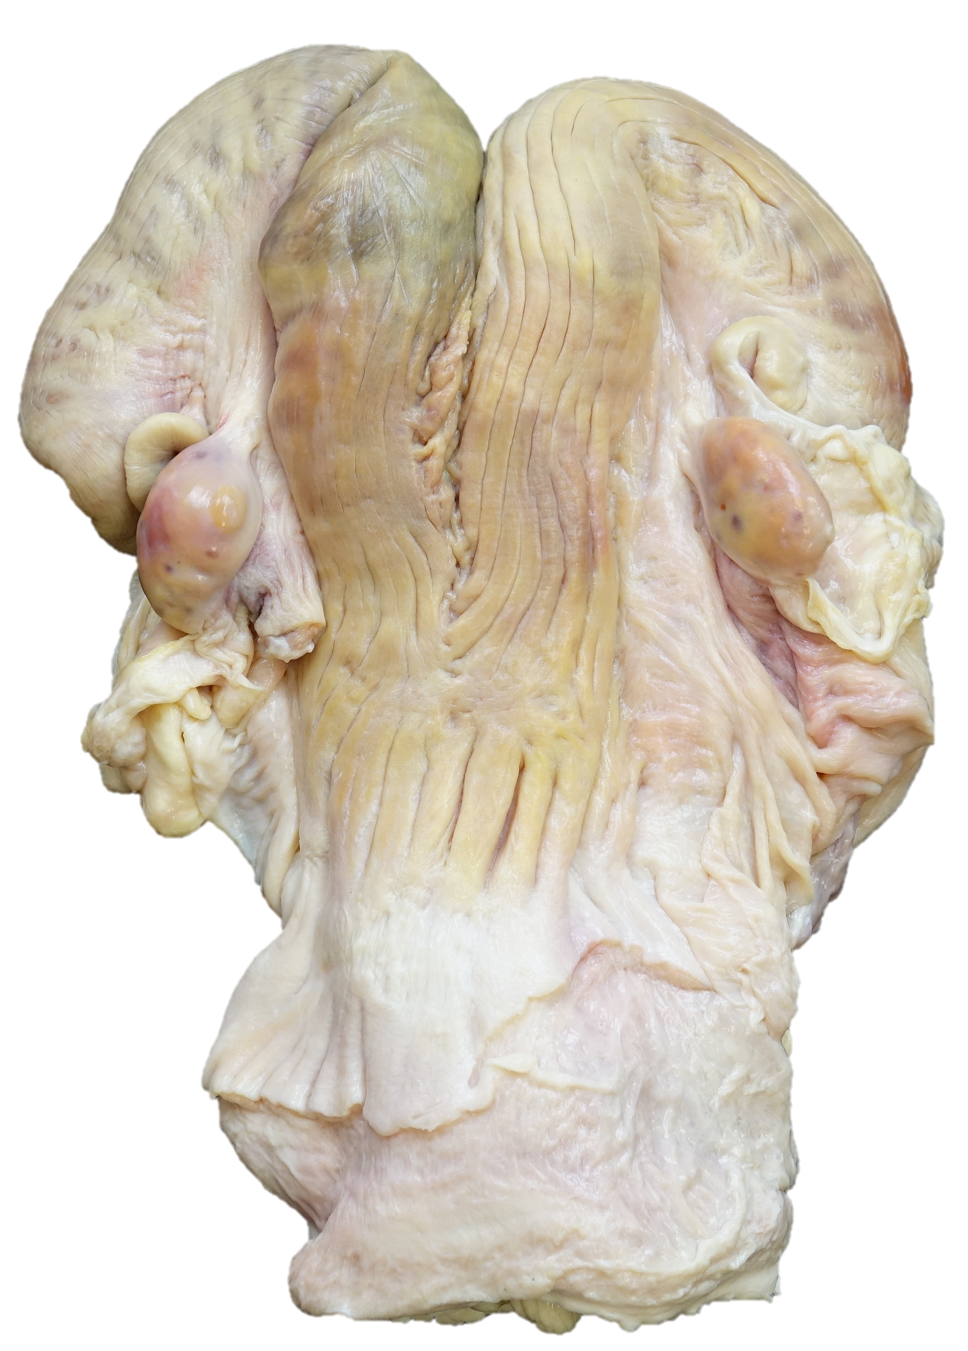
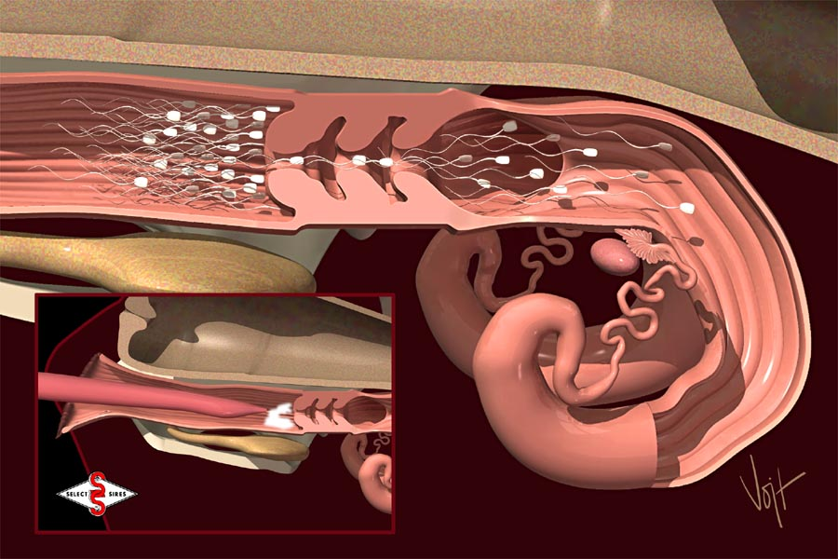
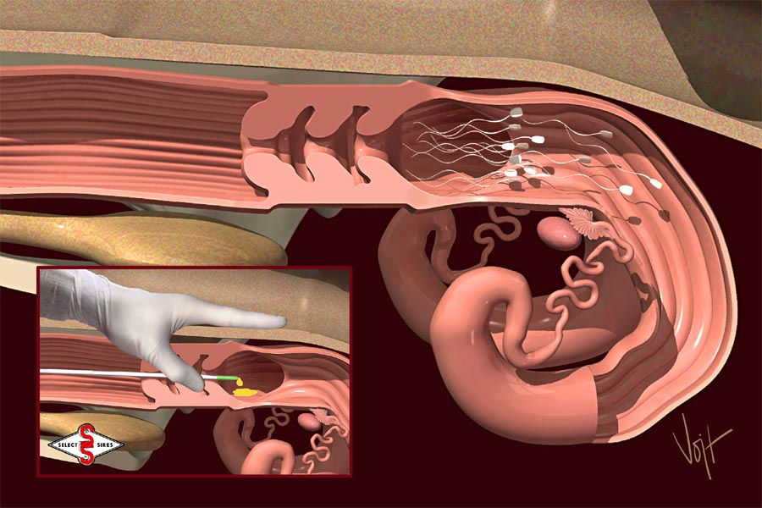
Artificial Insemination – Site of Semen Deposition
ovary
ovary
uterine body
cervix
Notes:
Finally, where should the semen be deposited? As indicated earlier, while the bull will likely deposit semen into the vagina, with AI (CLICK), because of the minute fraction of semen used, we must strive to place that semen as close to the point of ovulation as possible. That means we must thread the AI rod through the cervix (CLICK) and deposit that semen on the anterior side, in the uterine body. Why should we be careful not to push the AI rod in farther, even closer to the ovary? (CLICK), because there are two ovaries, one at the end of each uterine horn, and we have no idea from which side she might ovulate.
NEXT SLIDE

Slide 17
Artificial Insemination – Biology (Day of Estrous Cycle)
Cow ovulates ~ 28 hours AFTER the ONSET of estrus
Estrogen level,
size of preovulatory
follicle
Progesterone level,
size of corpus luteum
estrus
estrus
0 5 10 15 21
Notes:
So, even if we do EVERYTHING right, currently, the maximal pregnancy rate with artificial insemination in cattle is approximately 60%, but that’s ONLY if the cow is in the right biological state to facilitate conception. Thus, the second part of this simulation was for you to identify the biological states that facilitate success with usage of artificial insemination.
So, on what day of the estrous cycle, should you breed? It all comes back to this chart (CLICK). Day zero, that’s when estrogen is high with presence of a large preovulatory follicle that is about to burst. However, you shouldn’t breed immediately upon seeing telltale signs of estrus because the cow (CLICK) doesn’t ovulate until approximately 28 hours AFTER the onset of estrus.
NEXT SLIDE

Slide 18
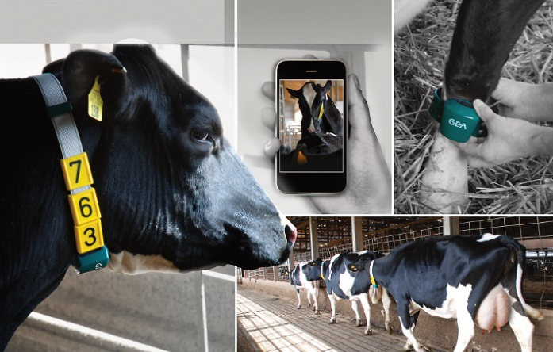
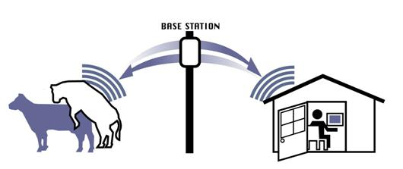
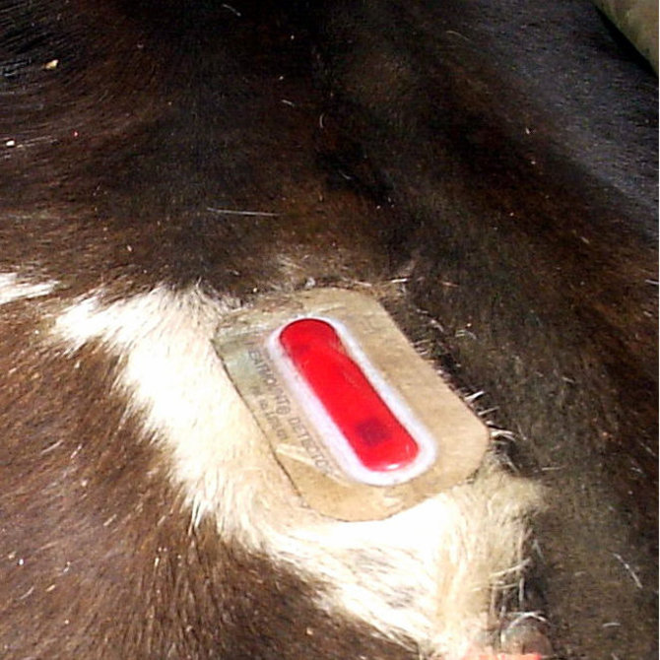
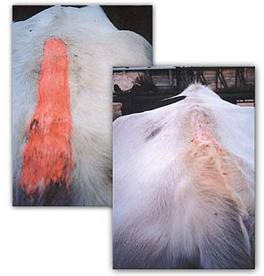
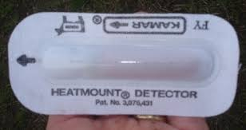
Artificial Insemination – Biology (Behavioral Signs)
Behavioral signs of estrus
  Stands when mounted
  Clear mucus discharge
  Nervous, “seek” the bull
May use markers
Notes:
Bos Taurus breeds of cattle that are common in most temperate climates will only show behavioral signs of estrus for approximately 18 hrs. Cattle of Bos Indicus influence, those bred for usage in tropical and sub-tropical regions of the world, such as the Southern U.S. will only show these behavioral signs for 6 hours, on average.
The tell-tale sign of estrus (CLICK) is when a cow stands when mounted. They may also exhibit a clear mucus discharge, and they’ll likely be nervous, but those are secondary, indicator signs.
Many operations will utilize markers to help identify those cows who are in heat. Those can be as simple as a chalk mark that is rubbed off as other cows mount or a patch that breaks open and changes color when cows are mounted. The marking device may also be very sophisticated with computer transponders placed on the cow’s back that record when, how often, and for how long cows stood when mounted. That information would then be relayed to a computer and analyzed. Many dairies use activity collars or pedometers to track changes in activity. Cows who are in estrus will be more active than those who are not.
NEXT SLIDE

Slide 19
Artificial Insemination – Biology (Hormone Profile)
21 days
Estrogen
Hormone Levels
Progesterone
estrus
estrus
0 5 10 15 21
days of estrous cycle
Notes:
What hormone provide should be present within the cow at the time of breeding to maximize the probability of pregnancy?
CLICK – Back to this wonderful chart (CLICK). Large amounts of estrogen will be secreted from large provulatory follicles that are about to release the egg. Cows should be bred when estrogen is high, and progesterone low.
NEXT SLIDE

Slide 20
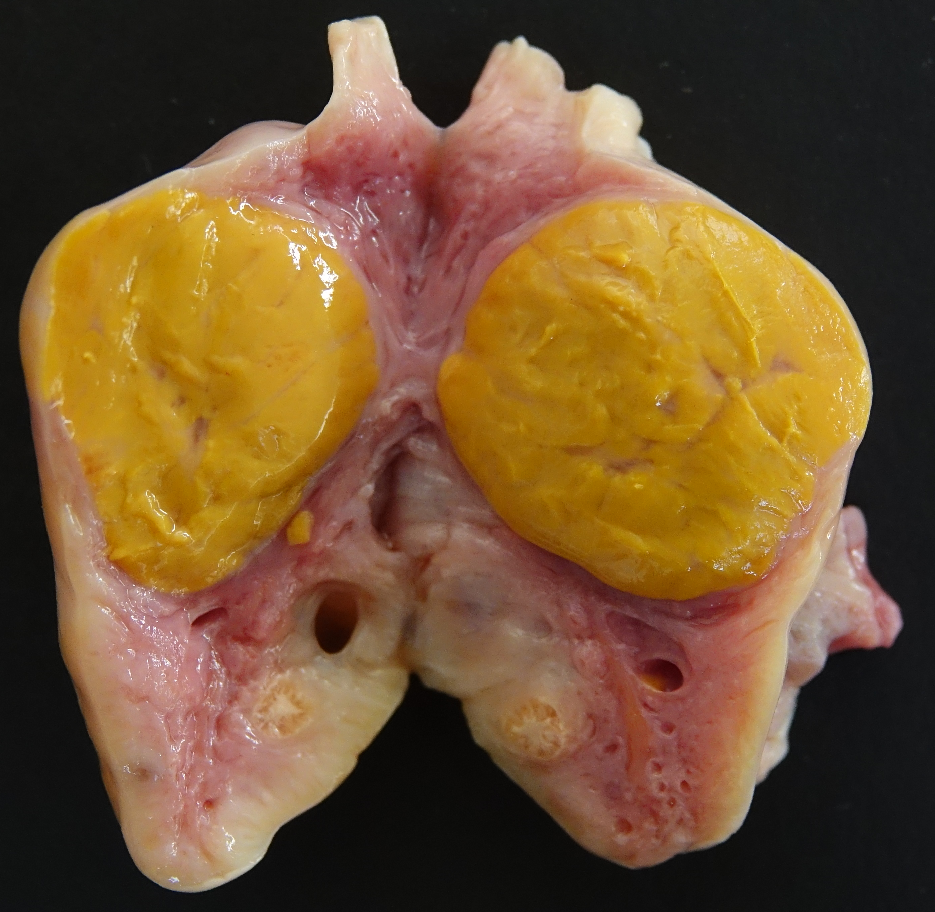
Artificial Insemination – Biology
(Reproductive Structures)
Follicles
  We need an egg!
  The egg to be ovulated is in the follicle
  Follicle secretes estrogen
Corpus luteum (CL)
  Structure that develops after ovulation of the follicle
  Secretes progesterone
Follicles
CL
Notes:
From a structure standpoint, you know the answer …
CLICK – We need an egg! And the egg to be ovulated is in that large preovulatory follicle that is secreting copious amounts of estrogen.
CLICK – The corpus luteum, that structure that develops after ovulation of the follicle, it’s not going to be present. If it were, the follicles couldn’t grow because of progesterone placing a roadblock on the flow of FSH or follicle stimulating hormone.
CLICK – No CL present
NEXT SLIDE

Slide 21
Reflection Questions
If pregnancy rates are typically reduced with usage of AI, why is AI so popular?
What key factors function to maximize the probability of pregnancy with usage of AI?
How can you most effectively identify cows who are in the proper biological state for artificial insemination?
Notes:
Hopefully, the initial discussion related to reproductive biology along with an explanation of components and questions associated with the learning activity helped prepare you to discus the reflection and application questions related to what you learned.
Hopefully, you’ve conducted some discussion related to these questions, but I’ll now give you my opinion in response to these questions.
CLICK -- So, if pregnancy rates are typically reduced with usage of AI, why is AI so popular? It really all has to do with genetics, the ability to identify and use elite sires that one could not afford otherwise. It also allows producers the opportunity to better identify sires that compliment individual cows.
CLICK – What key factors function to maximize the probability of pregnancy with usage of AI? Technique is extremely important, but perhaps even more important is identifying those cows that are in the correct stage of reproduction to maximize the odds of pregnancy.
CLICK – How can you most effectively identify cows who are in the proper biological state for artificial insemination? The most practical method is to simply observe the cows; they’re behavior will tell you when they are in estrus. Cows who stand, when mounted are in estrus, and ovulation occurs approximately 28 hrs after the onset of estrus.
NEXT SLIDE

Slide 22
Reflection Questions
What structure on the ovary contains the egg to be ovulated?
As a preovulatory follicle grows & approaches ovulation, it secretes estrogen. Identify two related functions of estrogen important for successful artificial insemination.
What is the purpose of the corpus luteum and the hormone progesterone?
Notes:
What structure on the ovary contains the egg to be ovulated? The preovulatory follicle.
CLICK -- As a preovulatory follicle grows & approaches ovulation, it secretes estrogen. Identify two related functions of estrogen important for successful artificial insemination. 1) Estrogen is responsible for estrous behavior, and 2) high levels of estrogen stimulate release of luteinizing hormone which causes ovulation. Unless the egg is ovulated near the time of insemination, odds of pregnancy decrease dramatically.
CLICK – What is the purpose of the corpus luteum and the hormone progesterone? The corpus luteum develops after release of the egg from the follicle. It secretes progesterone, for as long as the fertilized egg continues to grow and develop. Progesterone keeps the cow from returning to estrus by placing a “roadblock” on the release of follicle stimulating hormone or FSH.
NEXT SLIDE

Slide 23
Application Question
Given what you learned about the reproductive function of progesterone, how might you synchronize heifers so they all show estrus (mating behavior) at approximately the same time?
Methods
  “give & take” progesterone
    Create a hormonal state of pregnancy
    When removed, cycle starts over
Notes:
Now, I challenge you to apply some of the biological knowledge that you learned within this lesson. Because estrus synchronization is commonly used in conjunction with artificial insemination, how might you synchronize cows or heifers so they all show estrus or mating behavior at approximately the same time?
CLICK – What was the role of progesterone? To keep heat from recurring. Well, if cows were given an exogenous dosage of progesterone, we can hormonally trick the cows into thinking that they are pregnant. Then, after a period of time, if that progesterone is removed, the artificial roadblock on FSH will be removed, and all cows will start to grow follicles and come into estrus at approximately the same time. This is the basis of one commercially available estrus synchronization protocol.
NEXT SLIDE

